Slide 1



Portfolio management with principal component analysis in a Hong Kong’s stock market
Speaker：Zeng Yueqing 21096442
Liu Liangjie 21094937
Time：2024-12-18

Slide 2
行业PPT模板http://www.1ppt.com/hangye/
＄
01.
Hong Kong market and data Introduction
02.
PCA Methods
CONTENTS
A dream need to work out a summary report dream need to work out a need out a summary report summaryA dream need to work
03.
Portfolio Strategy Analysis Using PCA and Risk Parity Methods

Slide 3


PART 01
Hong Kong market and data Introduction
Personnel Business Recruitment Talents raining Elite Management Training TemplaRecruiTraining anagening Template
Personnel Business Recruitment Talents raining Elite Management Training TemplaRecruiTraining anagening Template
Notes:
模板来自于：第一PPT https://www.1ppt.com/

Slide 4

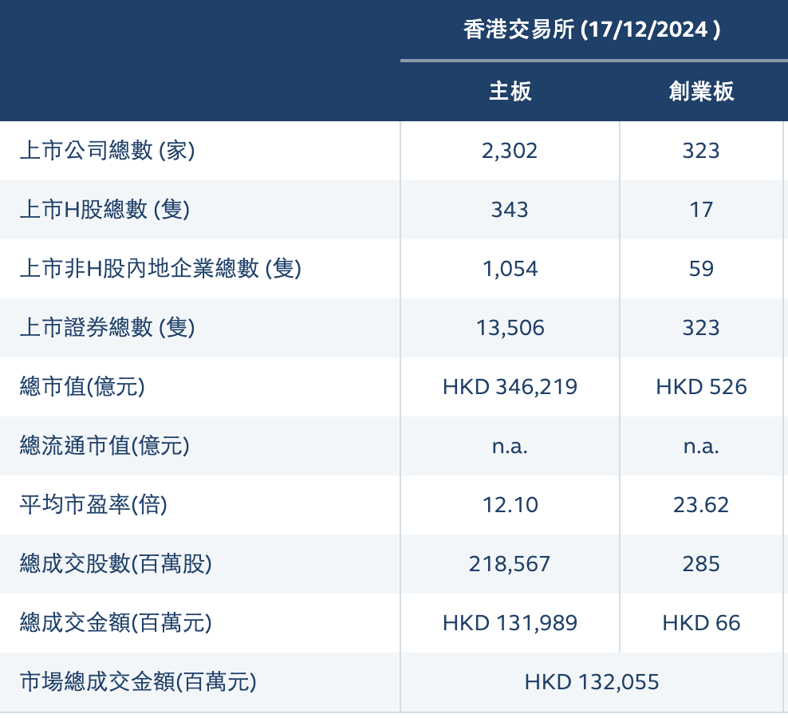
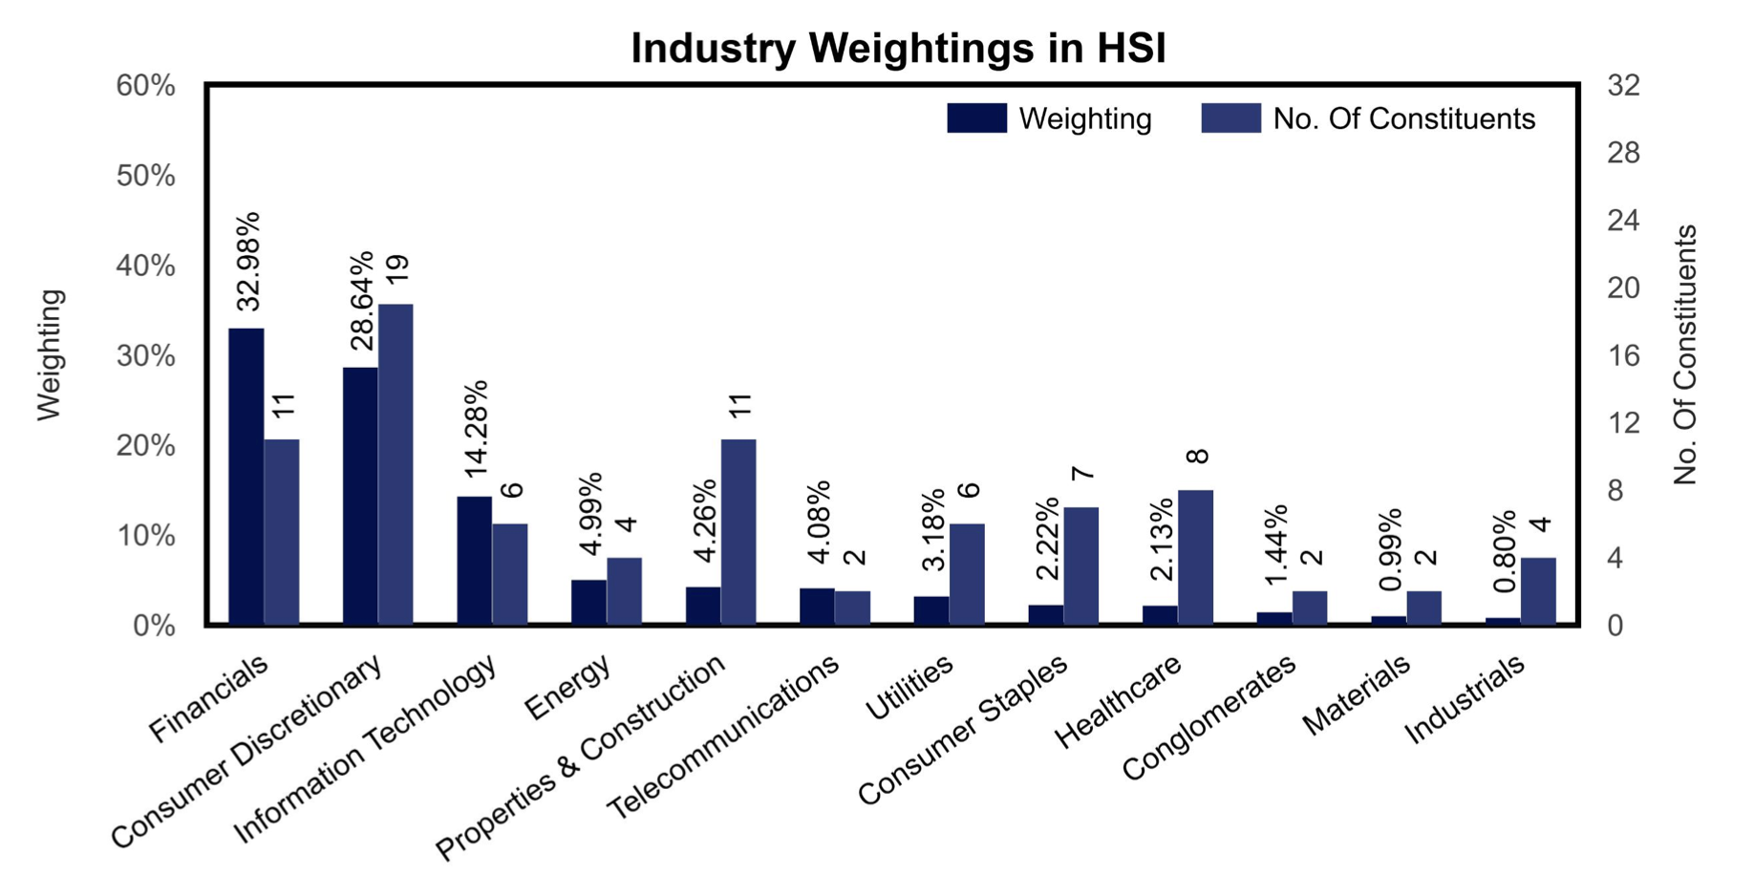
Hong Kong Stock Market
Hong Kong stocks refer to stocks listed on the Hong Kong Stock Exchange.
Hang Seng Index (HSI)
With over 2,200 companies listed on the Main Board and a total market capitalization of over HK$35 trillion, the Hong Kong stock market is one of the most actively traded and liquid stock markets in Asia and the world.

Slide 5

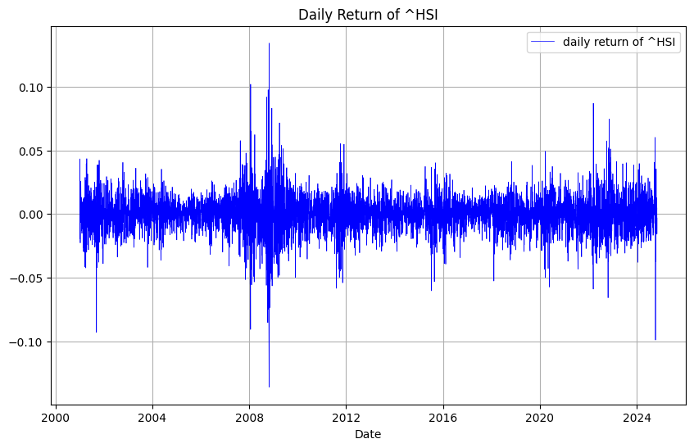
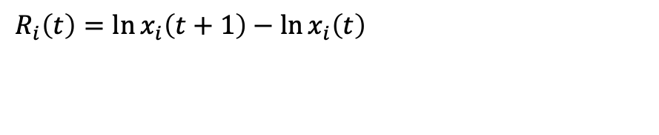
Data Introduction and Pre-processing
01
Download ‘Adj Close’ data of ^HSI and stocks：
Time：2001-01-01 to 2024-11-01
Data Cleaning
02
Clear all new entries and exits within this timeframe.
Final number of Stocks: 25
03
Get Daily Return
$$R_{i}\left(t\right)=\ln{x_{i}\left(t+1\right)}−\ln{x_{i}\left(t\right)}$$

Slide 6
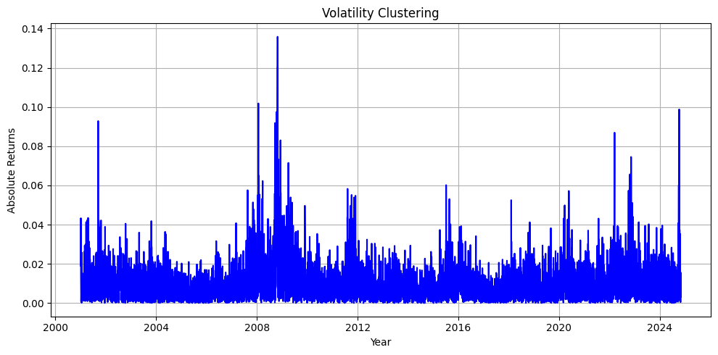
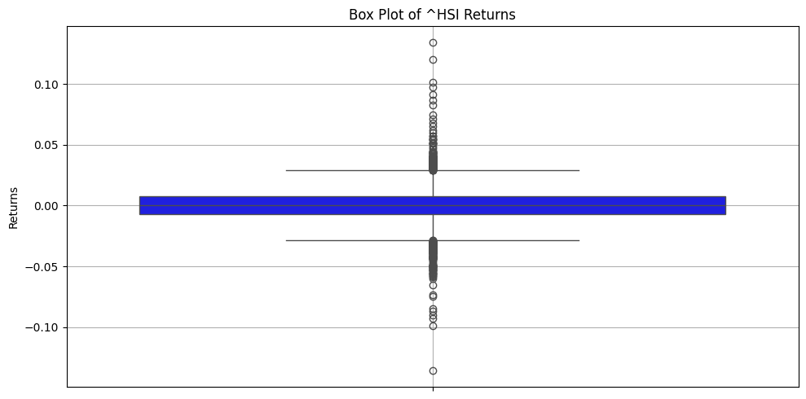
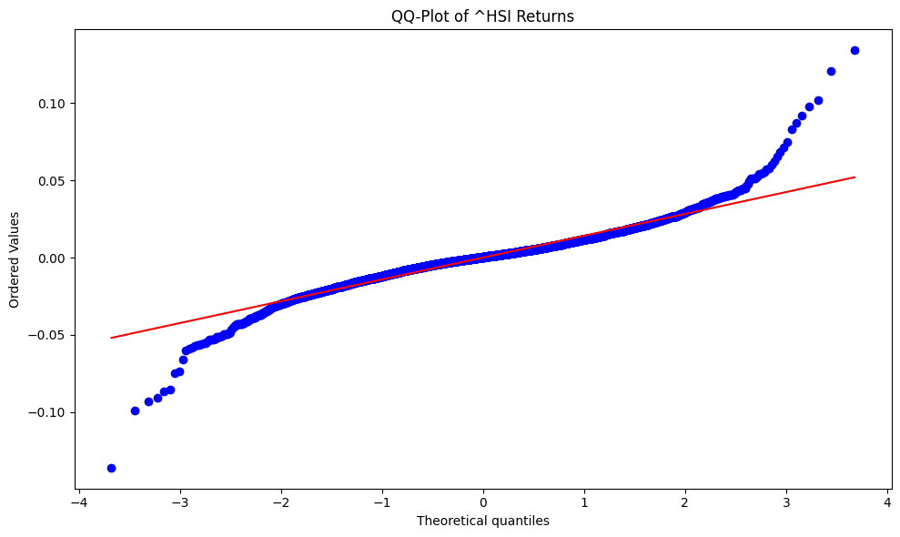
Data Introduction
Skewness of ^HSI Daily Returns: -0.0062
Kurtosis of ^HSI Daily Returns: 7.3513

Slide 7
PART 02
PCA Methods
Personnel Business Recruitment Talents raining Elite Management Training TemplaRecruiTraining anagening Template
Personnel Business Recruitment Talents raining Elite Management Training TemplaRecruiTraining anagening Template

Slide 8
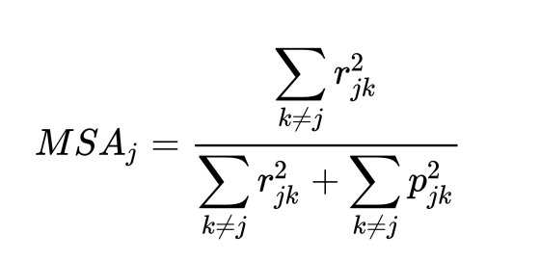
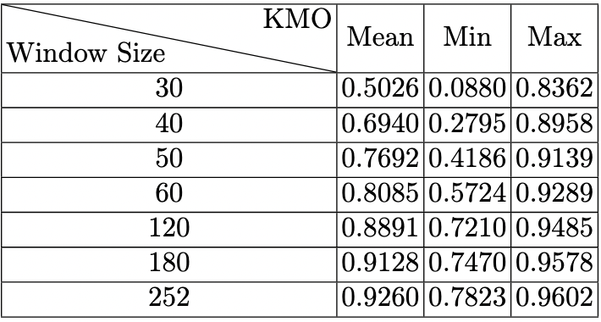
Kaiser-Meyer-Olkin Test (KMO)
KMO
test the shortest length of sliding window that a PCA could be
efficiently applied to
Formula:
MSA ∈ [0, 1]
MSA → 1, the investigated stocks share more common variation
MSA → 0, the PCA will not extract much useful information

Slide 9
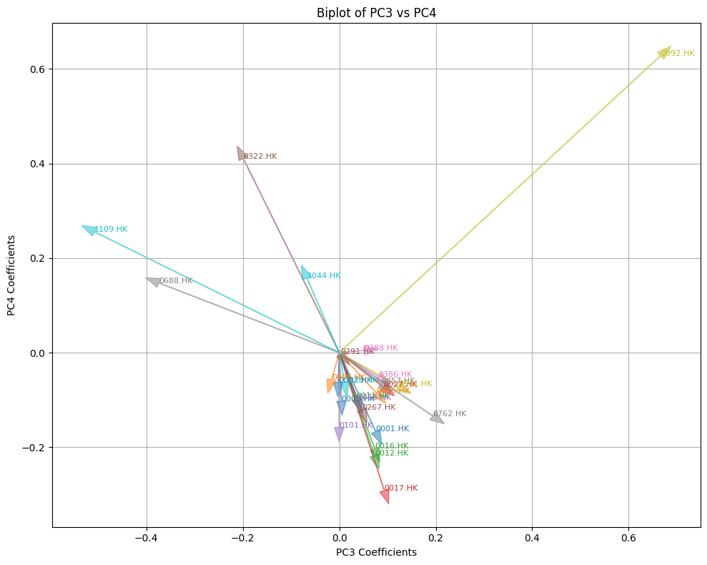
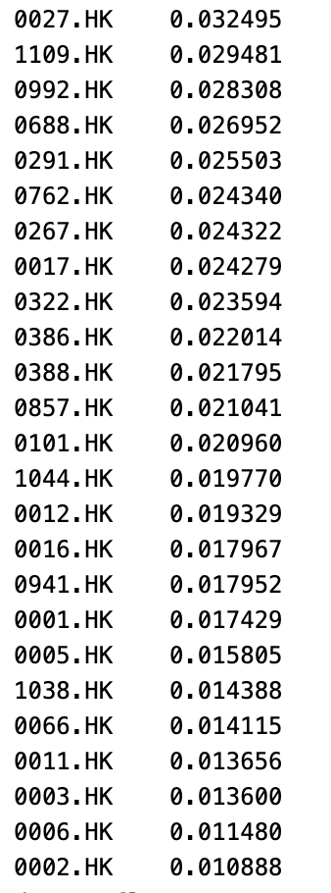
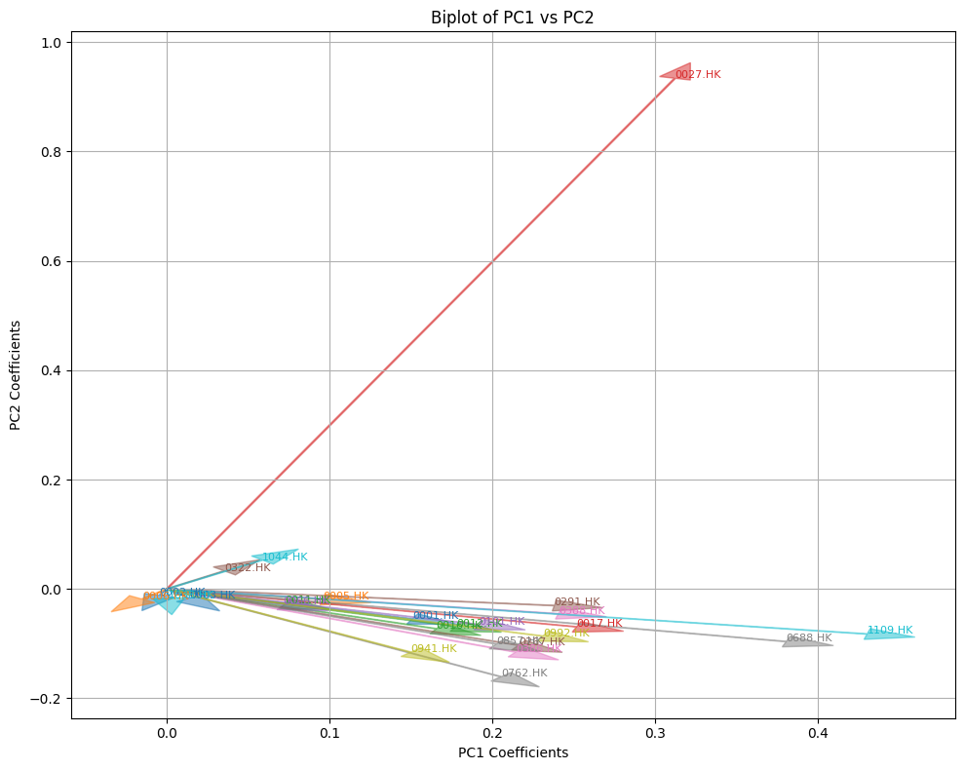
Apply PCA to Covariance Matrix
0992.HK
Standard Deviation
1109.HK
0027.HK
The important coefficient =
largest Standard Deviation
No illustration of the correlation structure within the stocks
1109.HK

Slide 10
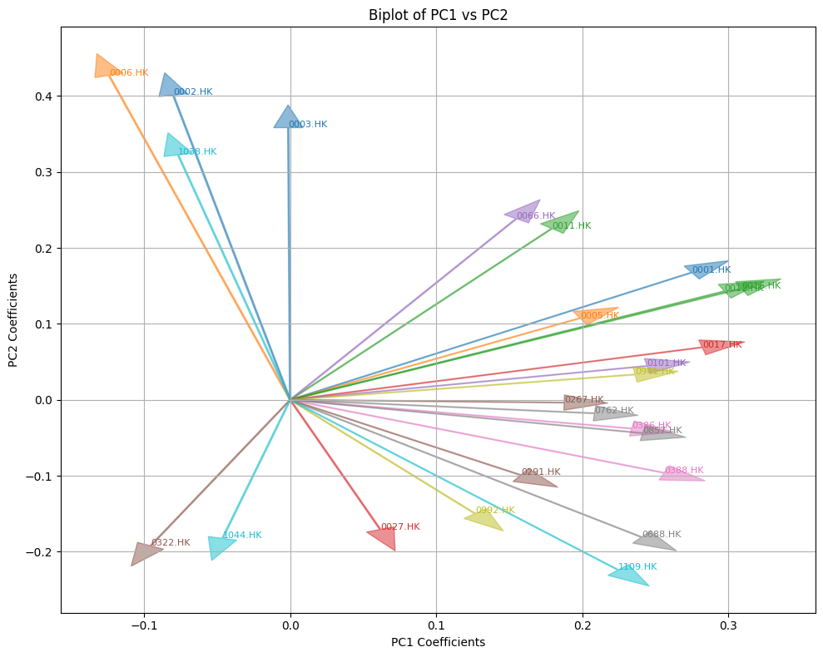
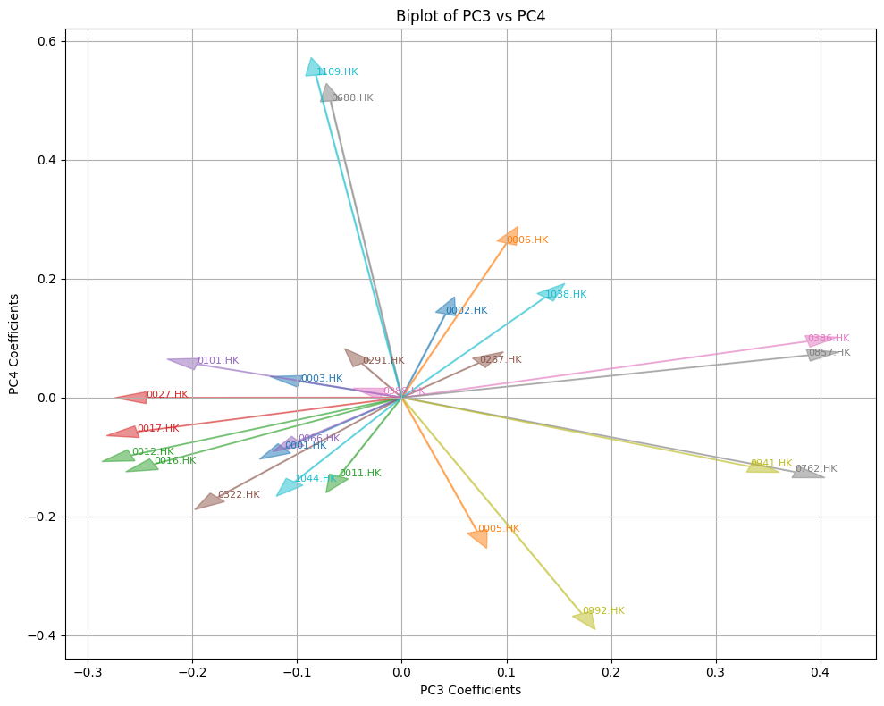
Apply PCA to Correlation Matrix

Slide 11
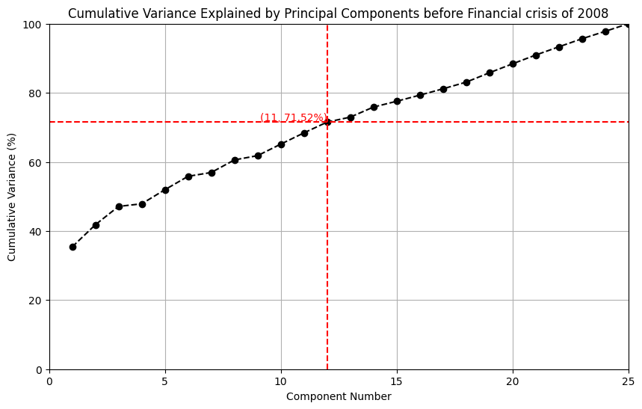
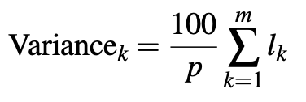
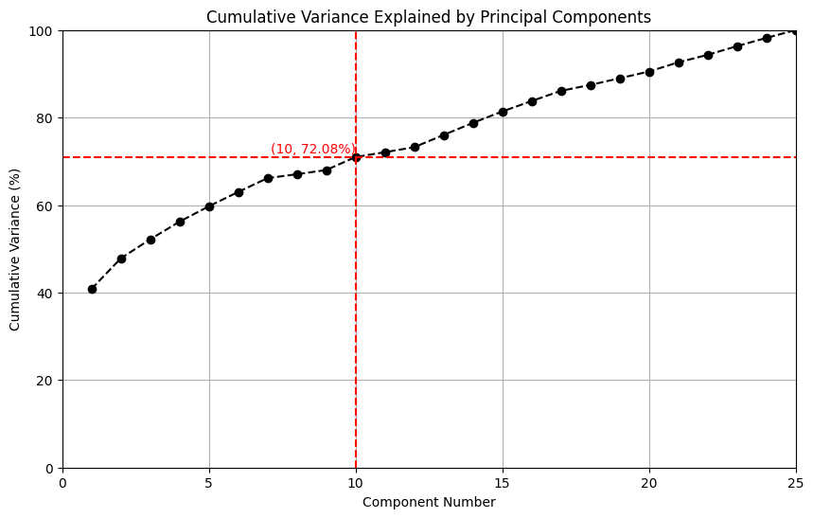
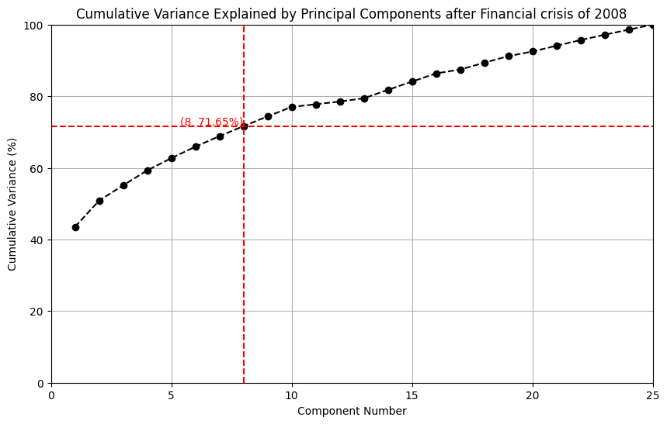
Select Retained Components
1
cumulative variance desired

Slide 12
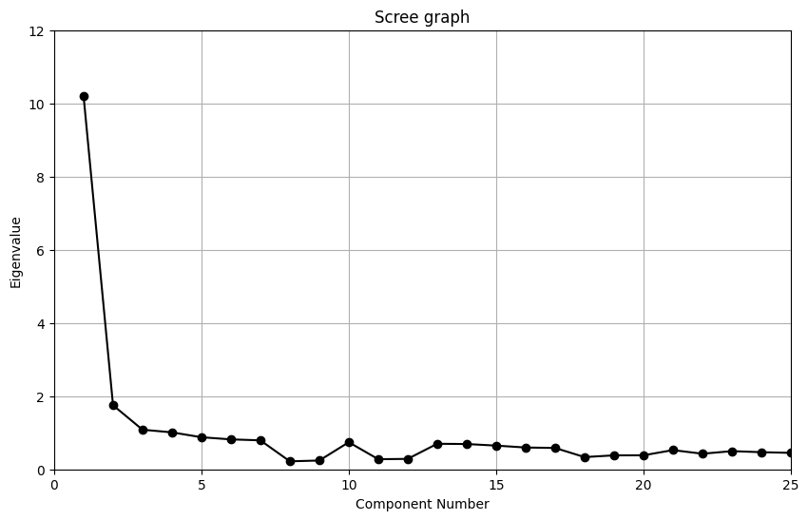
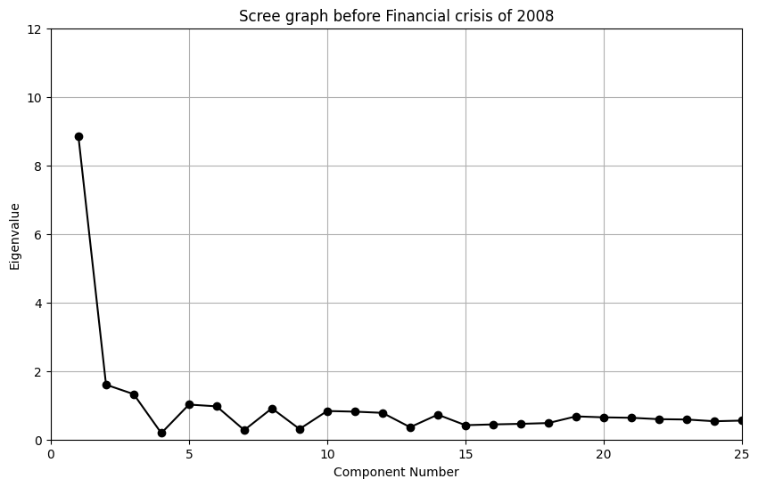

Select Retained Components
2
Kaiser’s rule:
retaining principal components that have an eigenvalue greater than 1.
retained components of all period are:['PC[1 2 3 4]’]
retained components before 2008 financial crisis are:['PC[1 2 3 5]’]
retained components after are 2008 financial crisis are :['PC[1 2 3 4]']
3
scree graph: a plot of eigenvalue against component number

Slide 13
PART 03
Portfolio Strategy Analysis Using PCA
and Risk Parity Methods
Personnel Business Recruitment Talents raining Elite Management Training TemplaRecruiTraining anagening Template

Slide 14
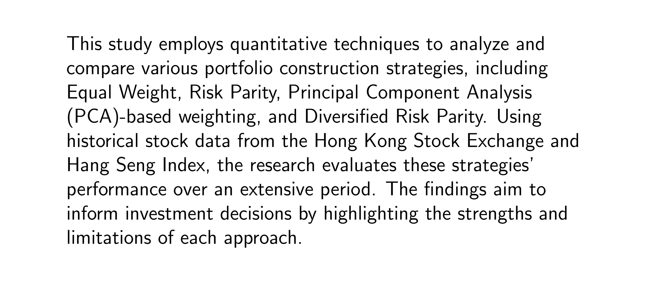

Slide 15
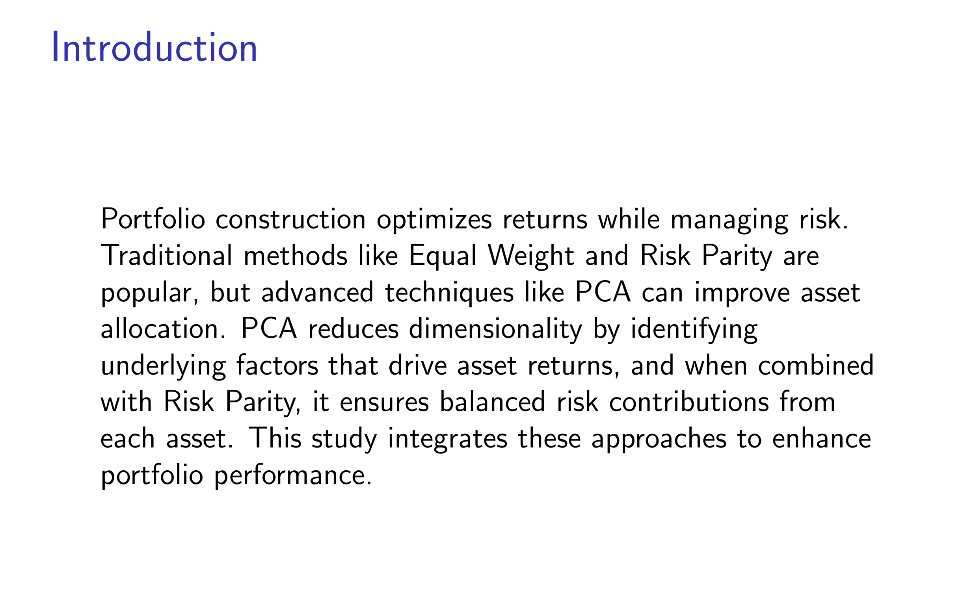

Slide 16
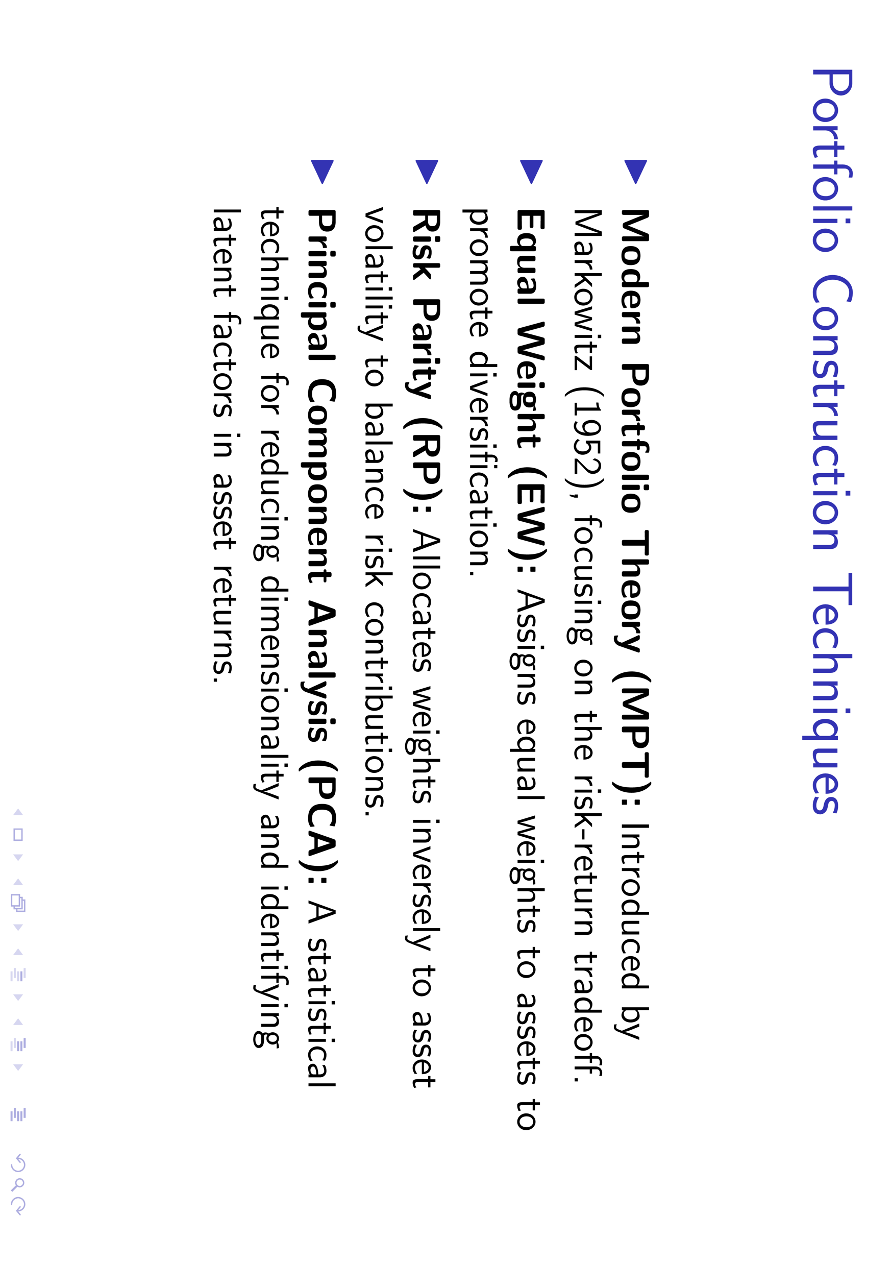

Slide 17
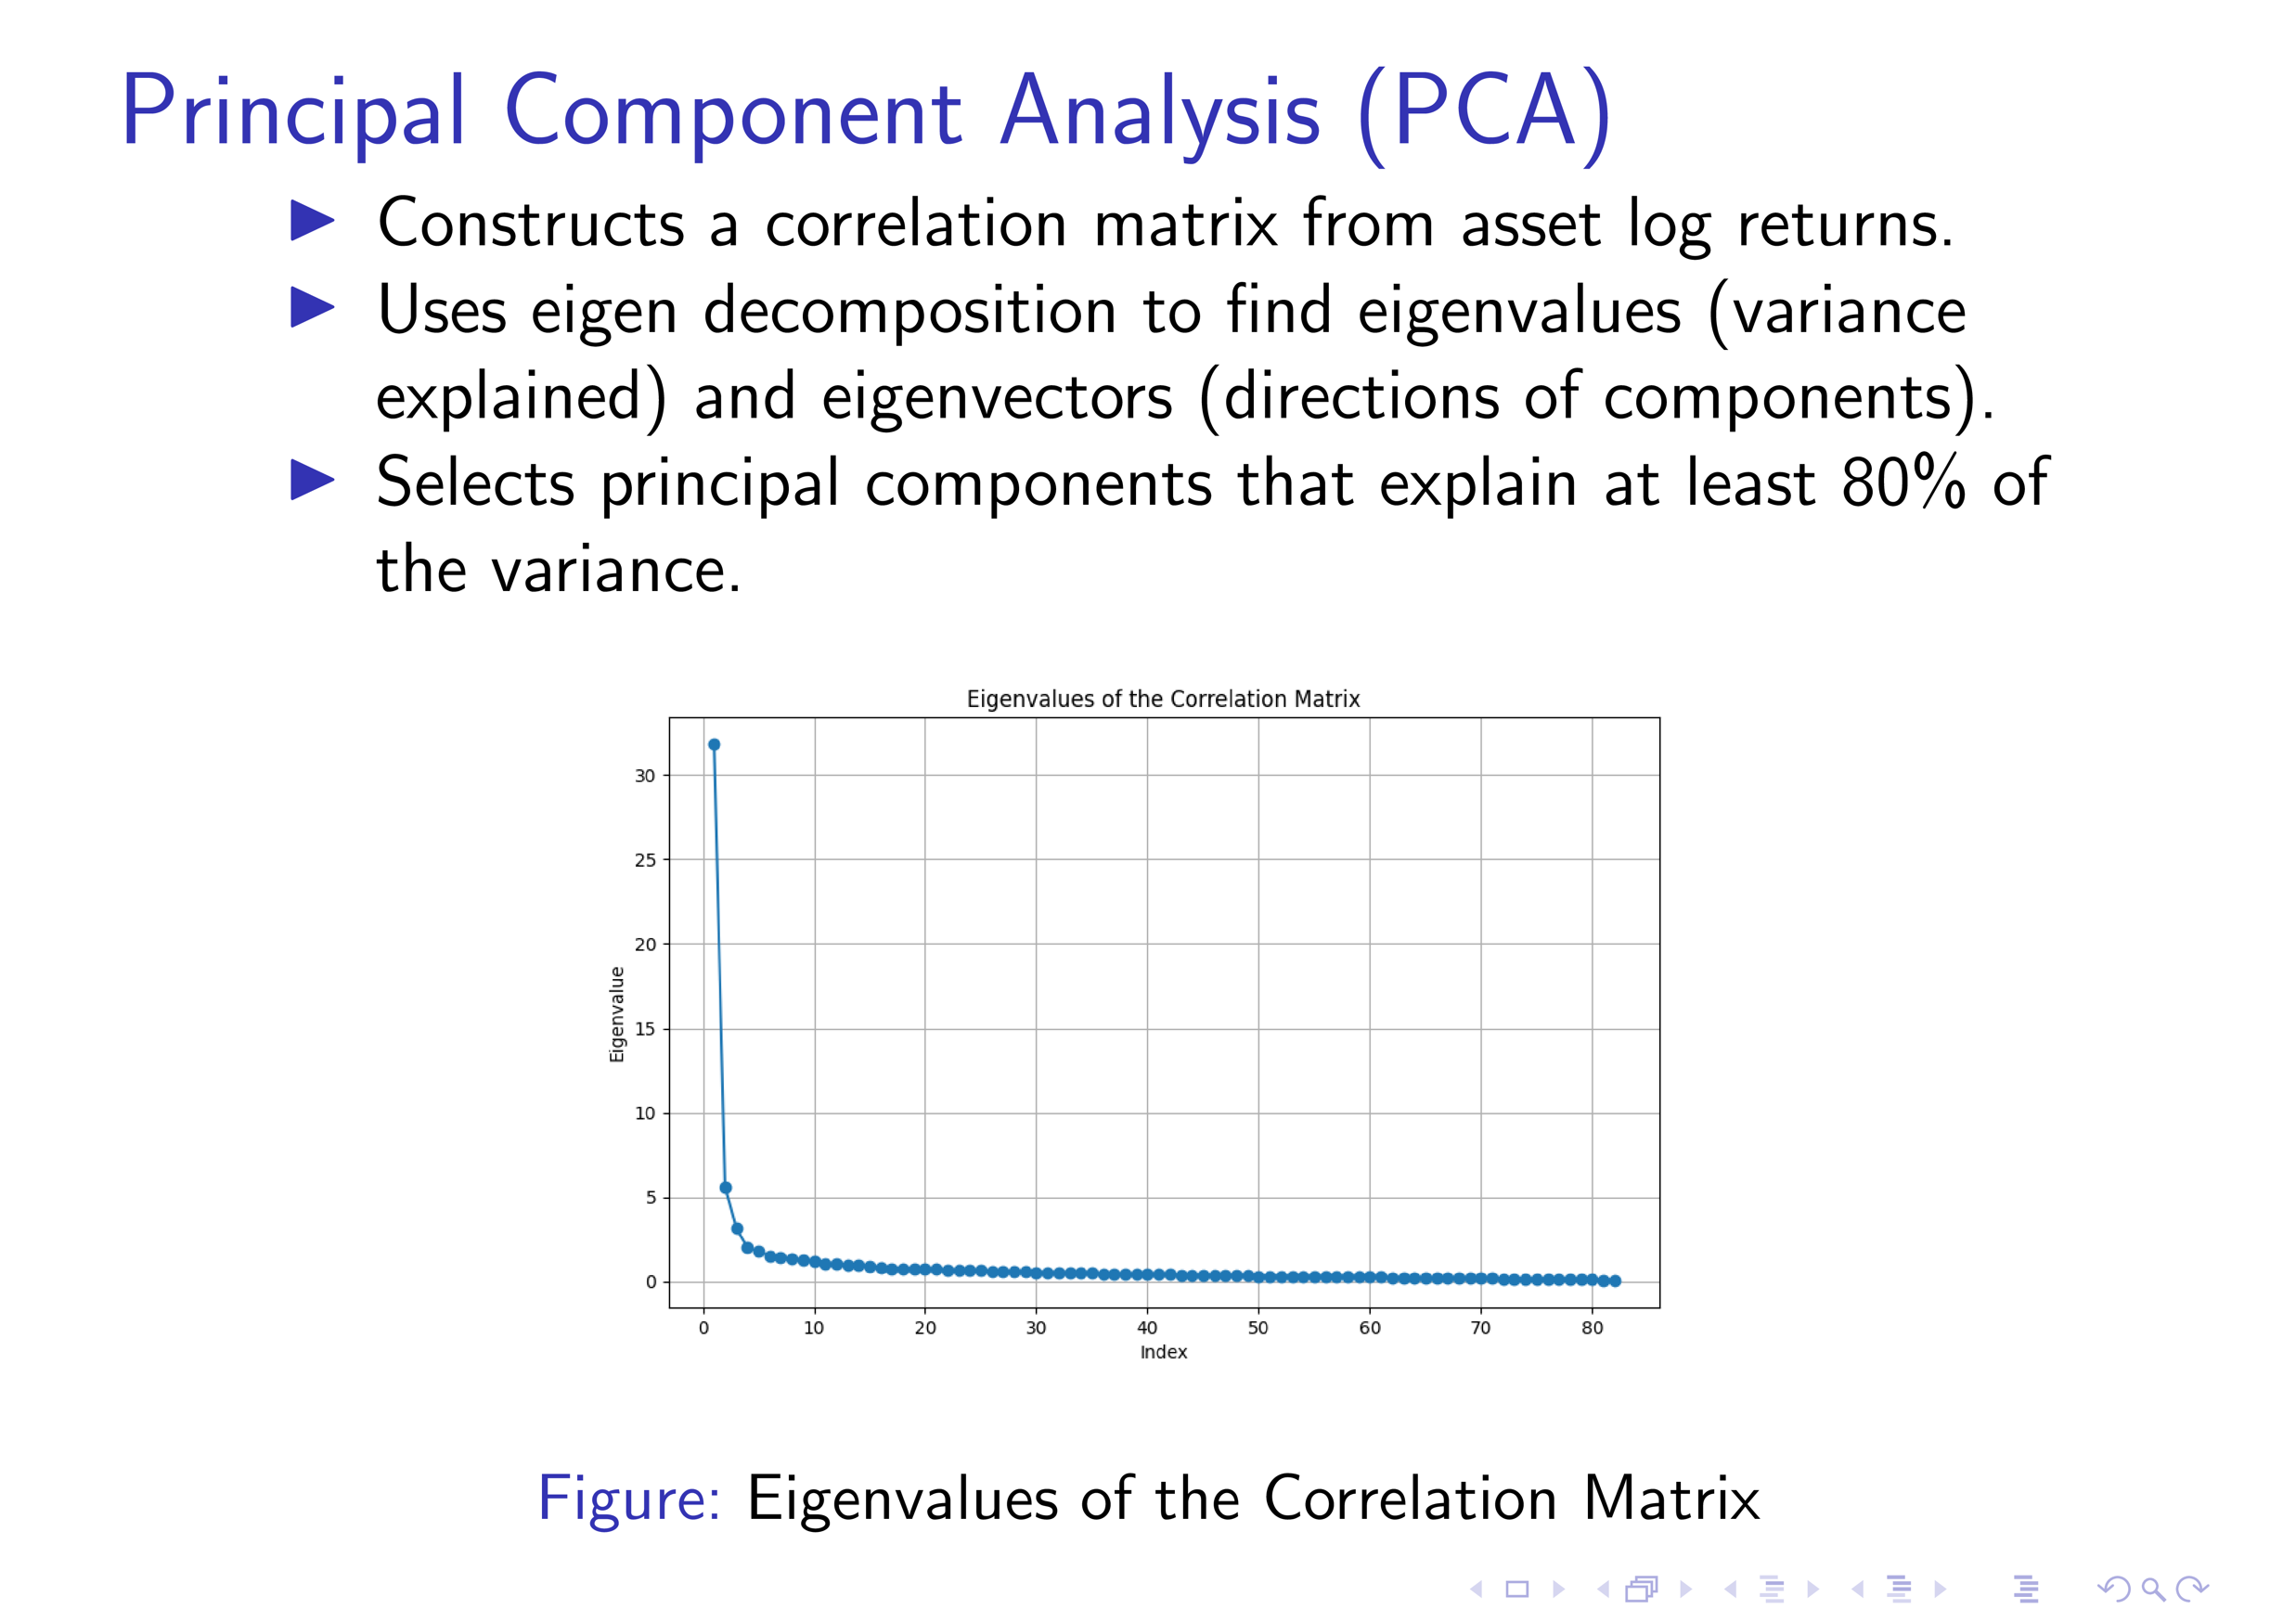

Slide 18
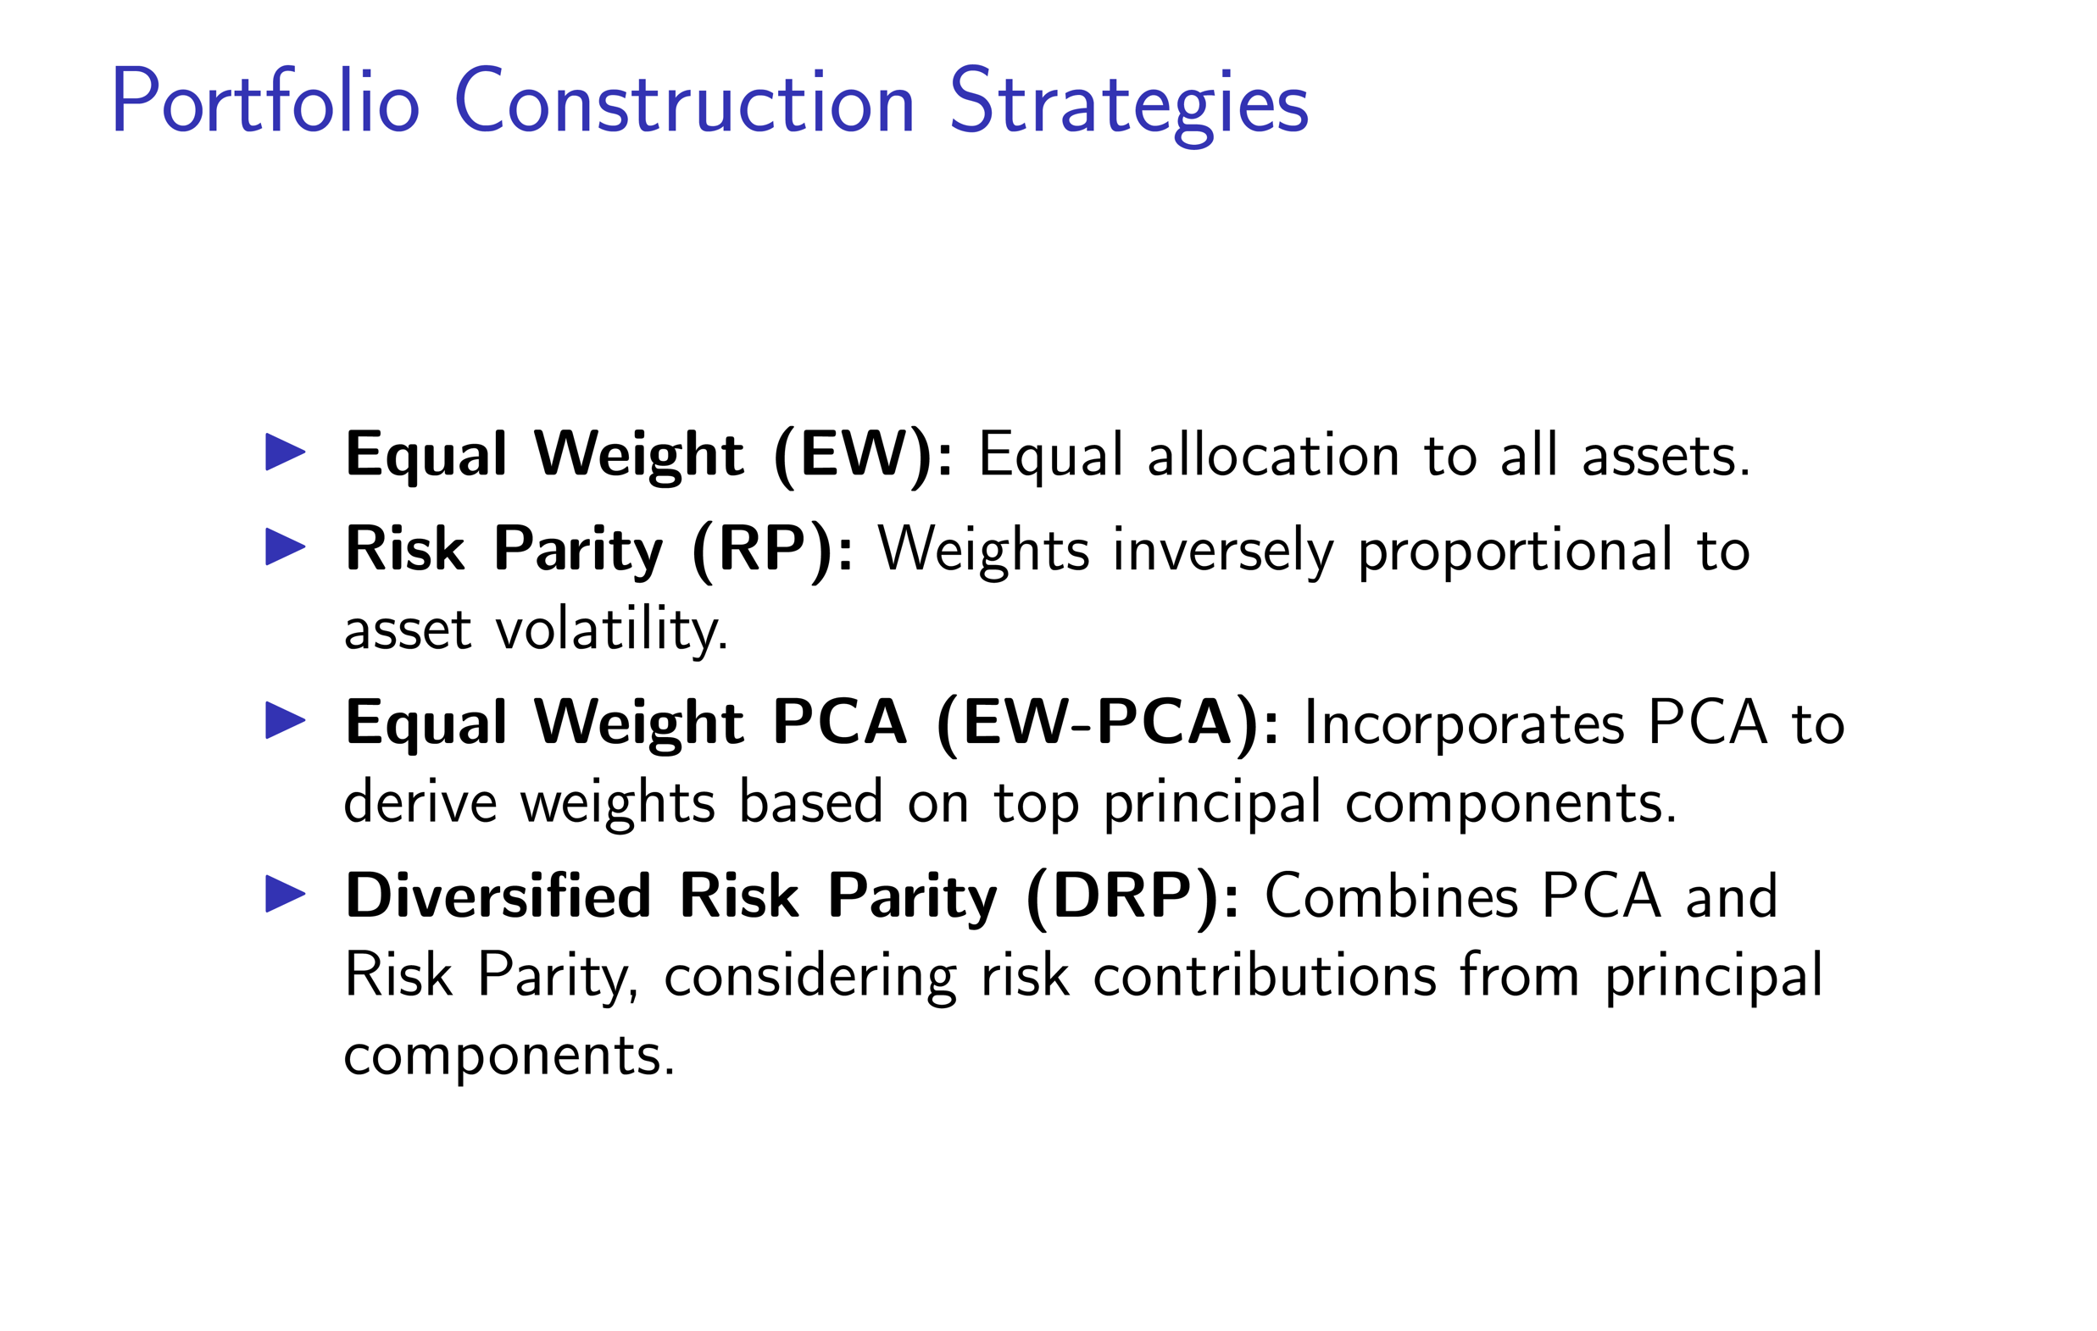

Slide 19
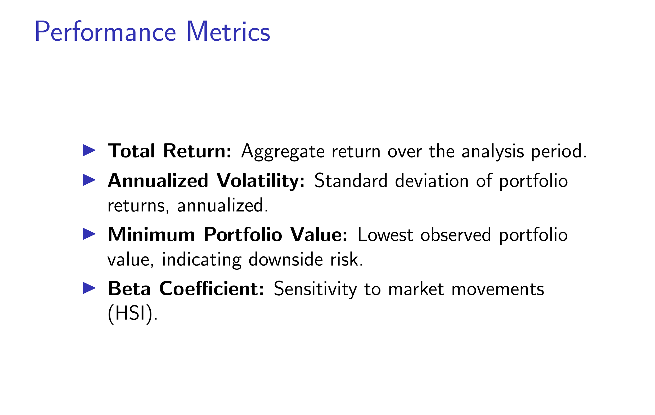

Slide 20
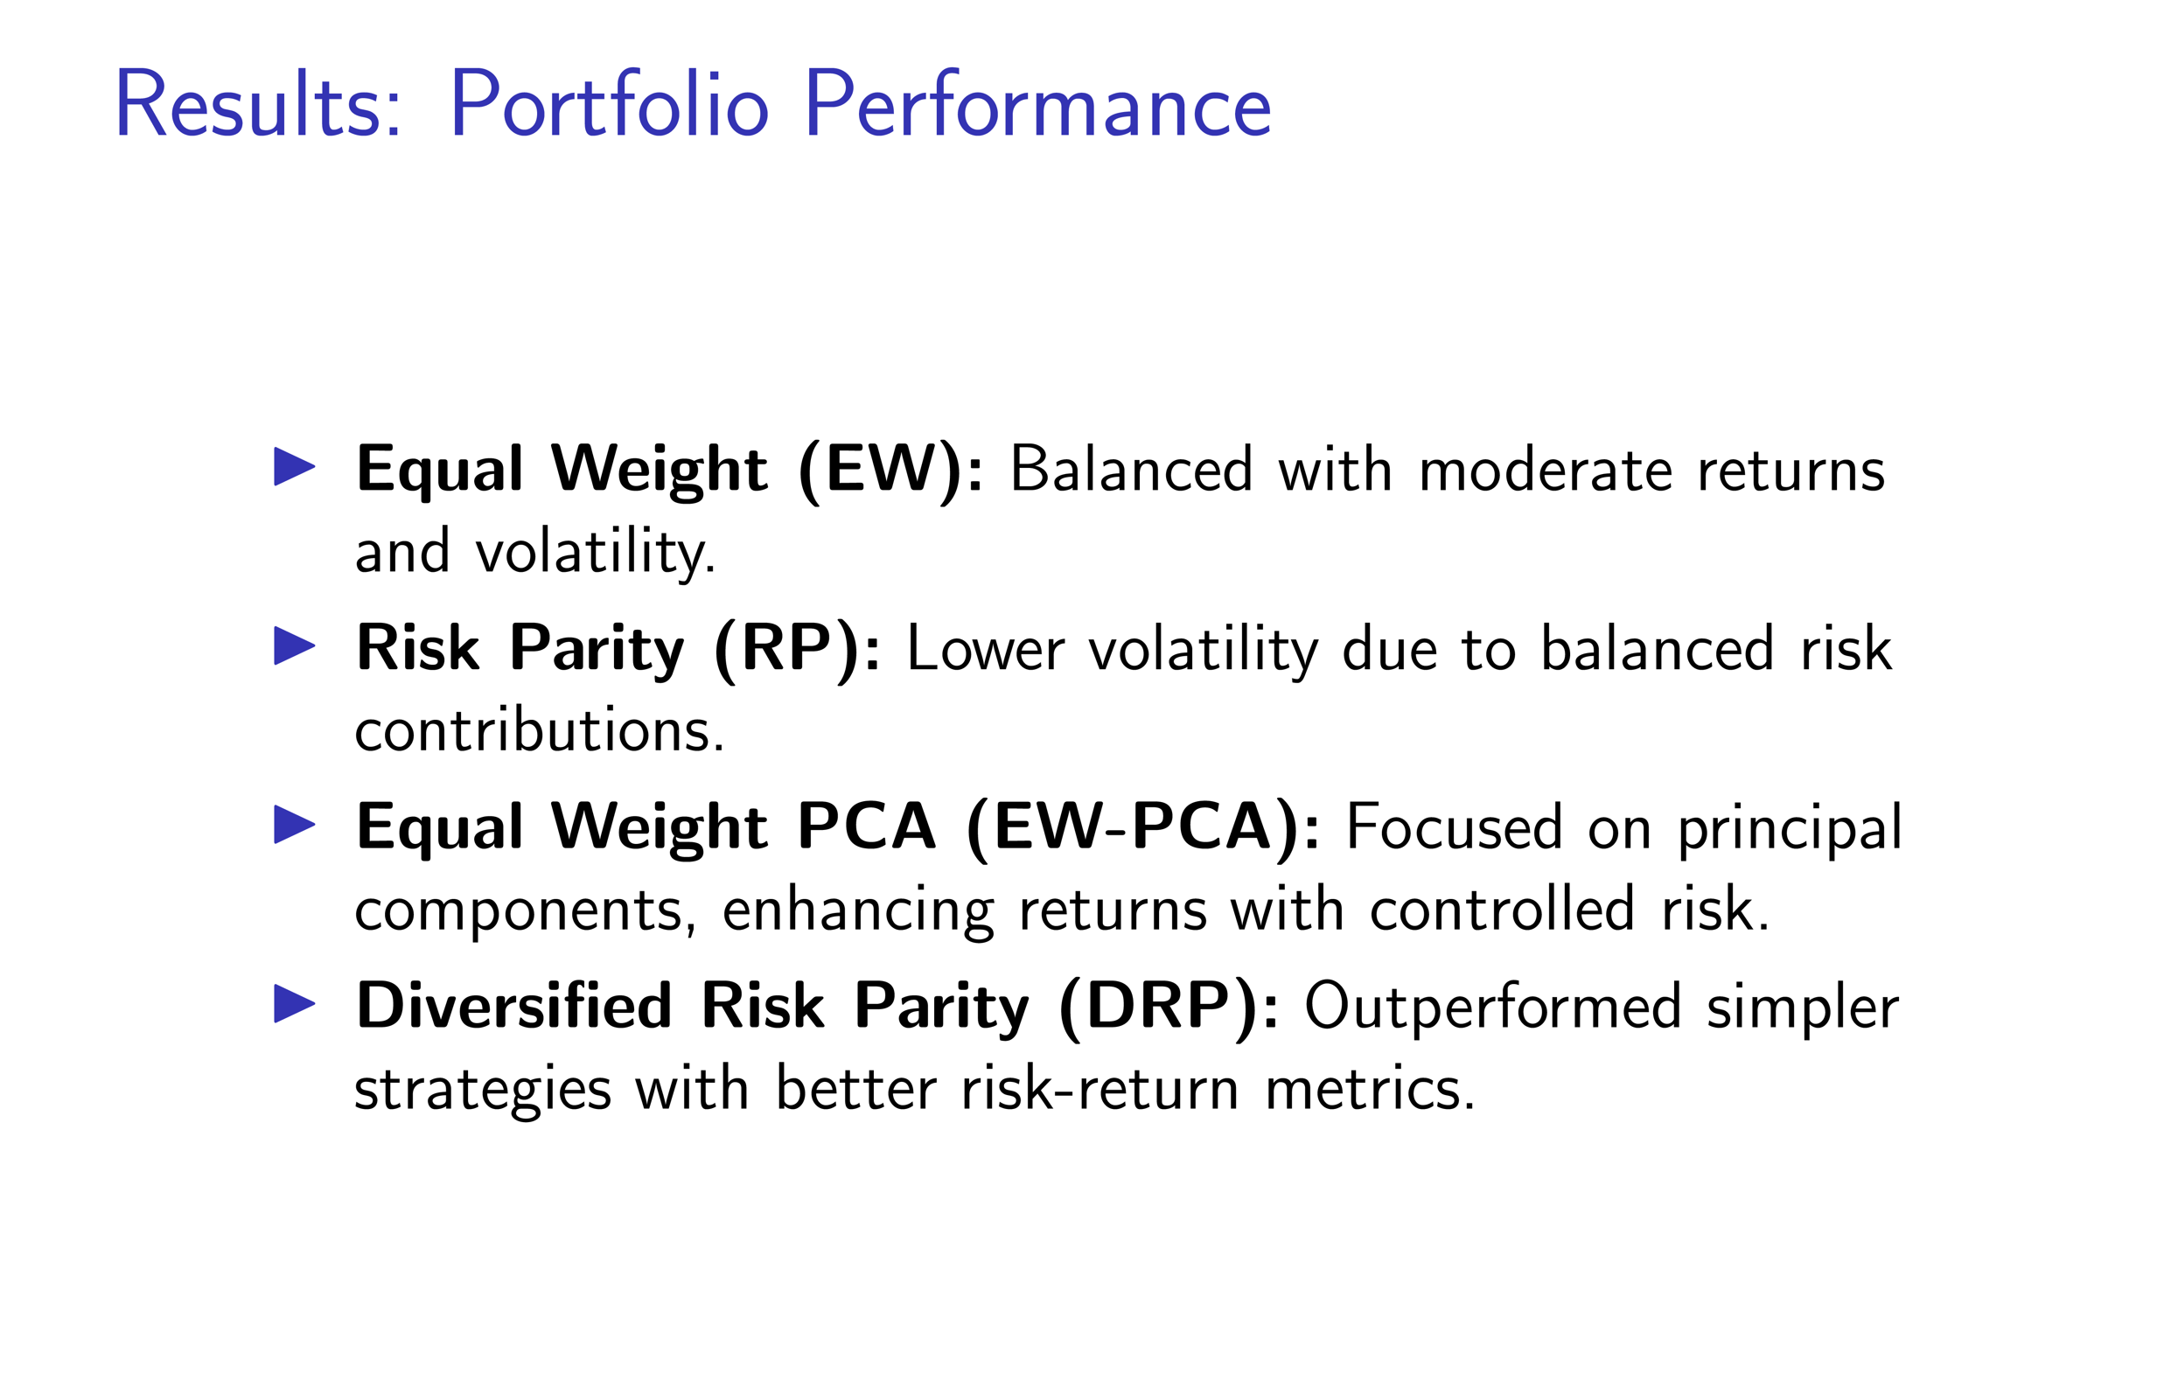

Slide 21
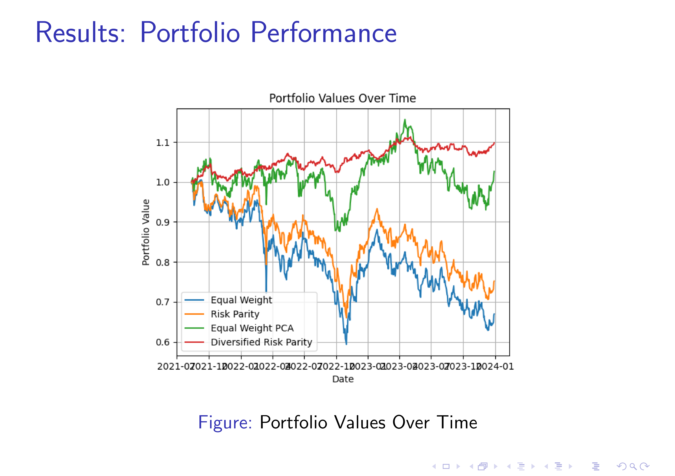

Slide 22
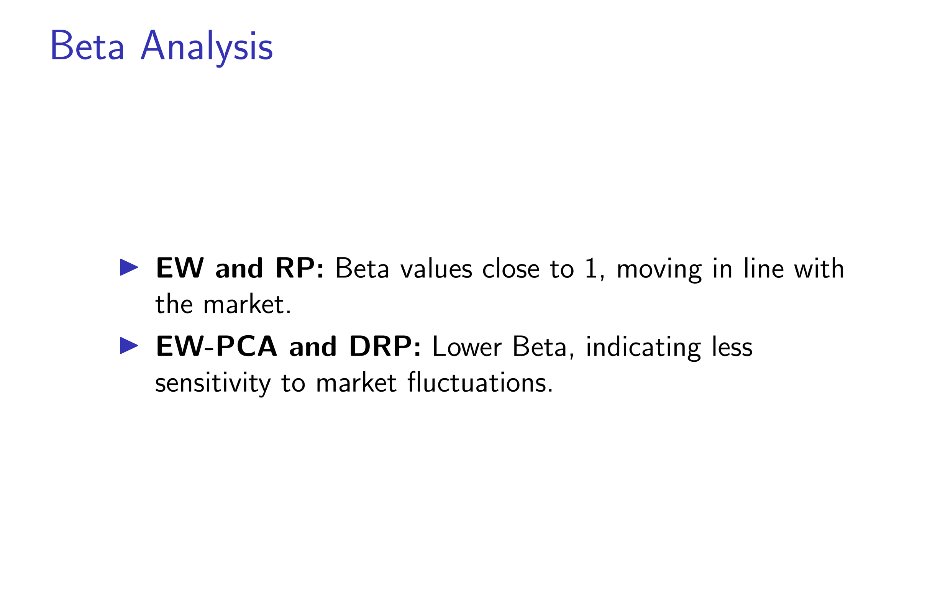

Slide 23
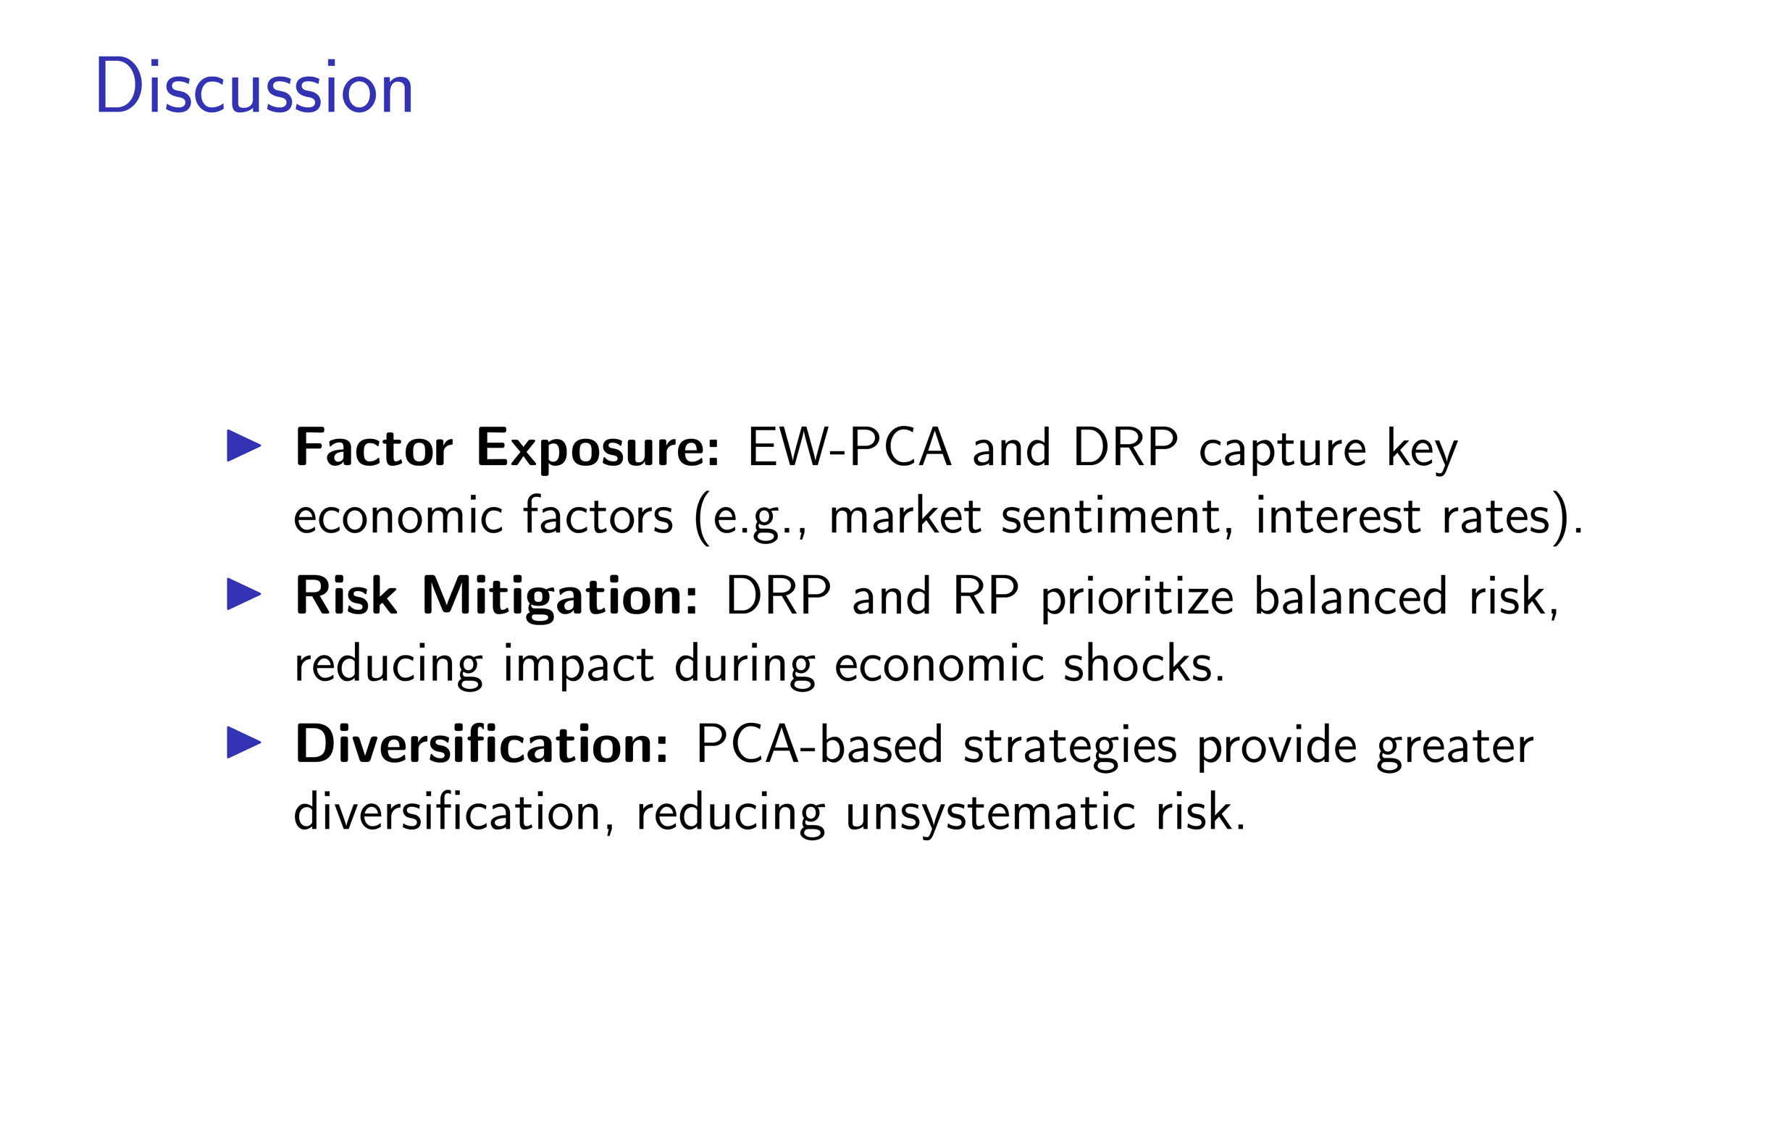

Slide 24
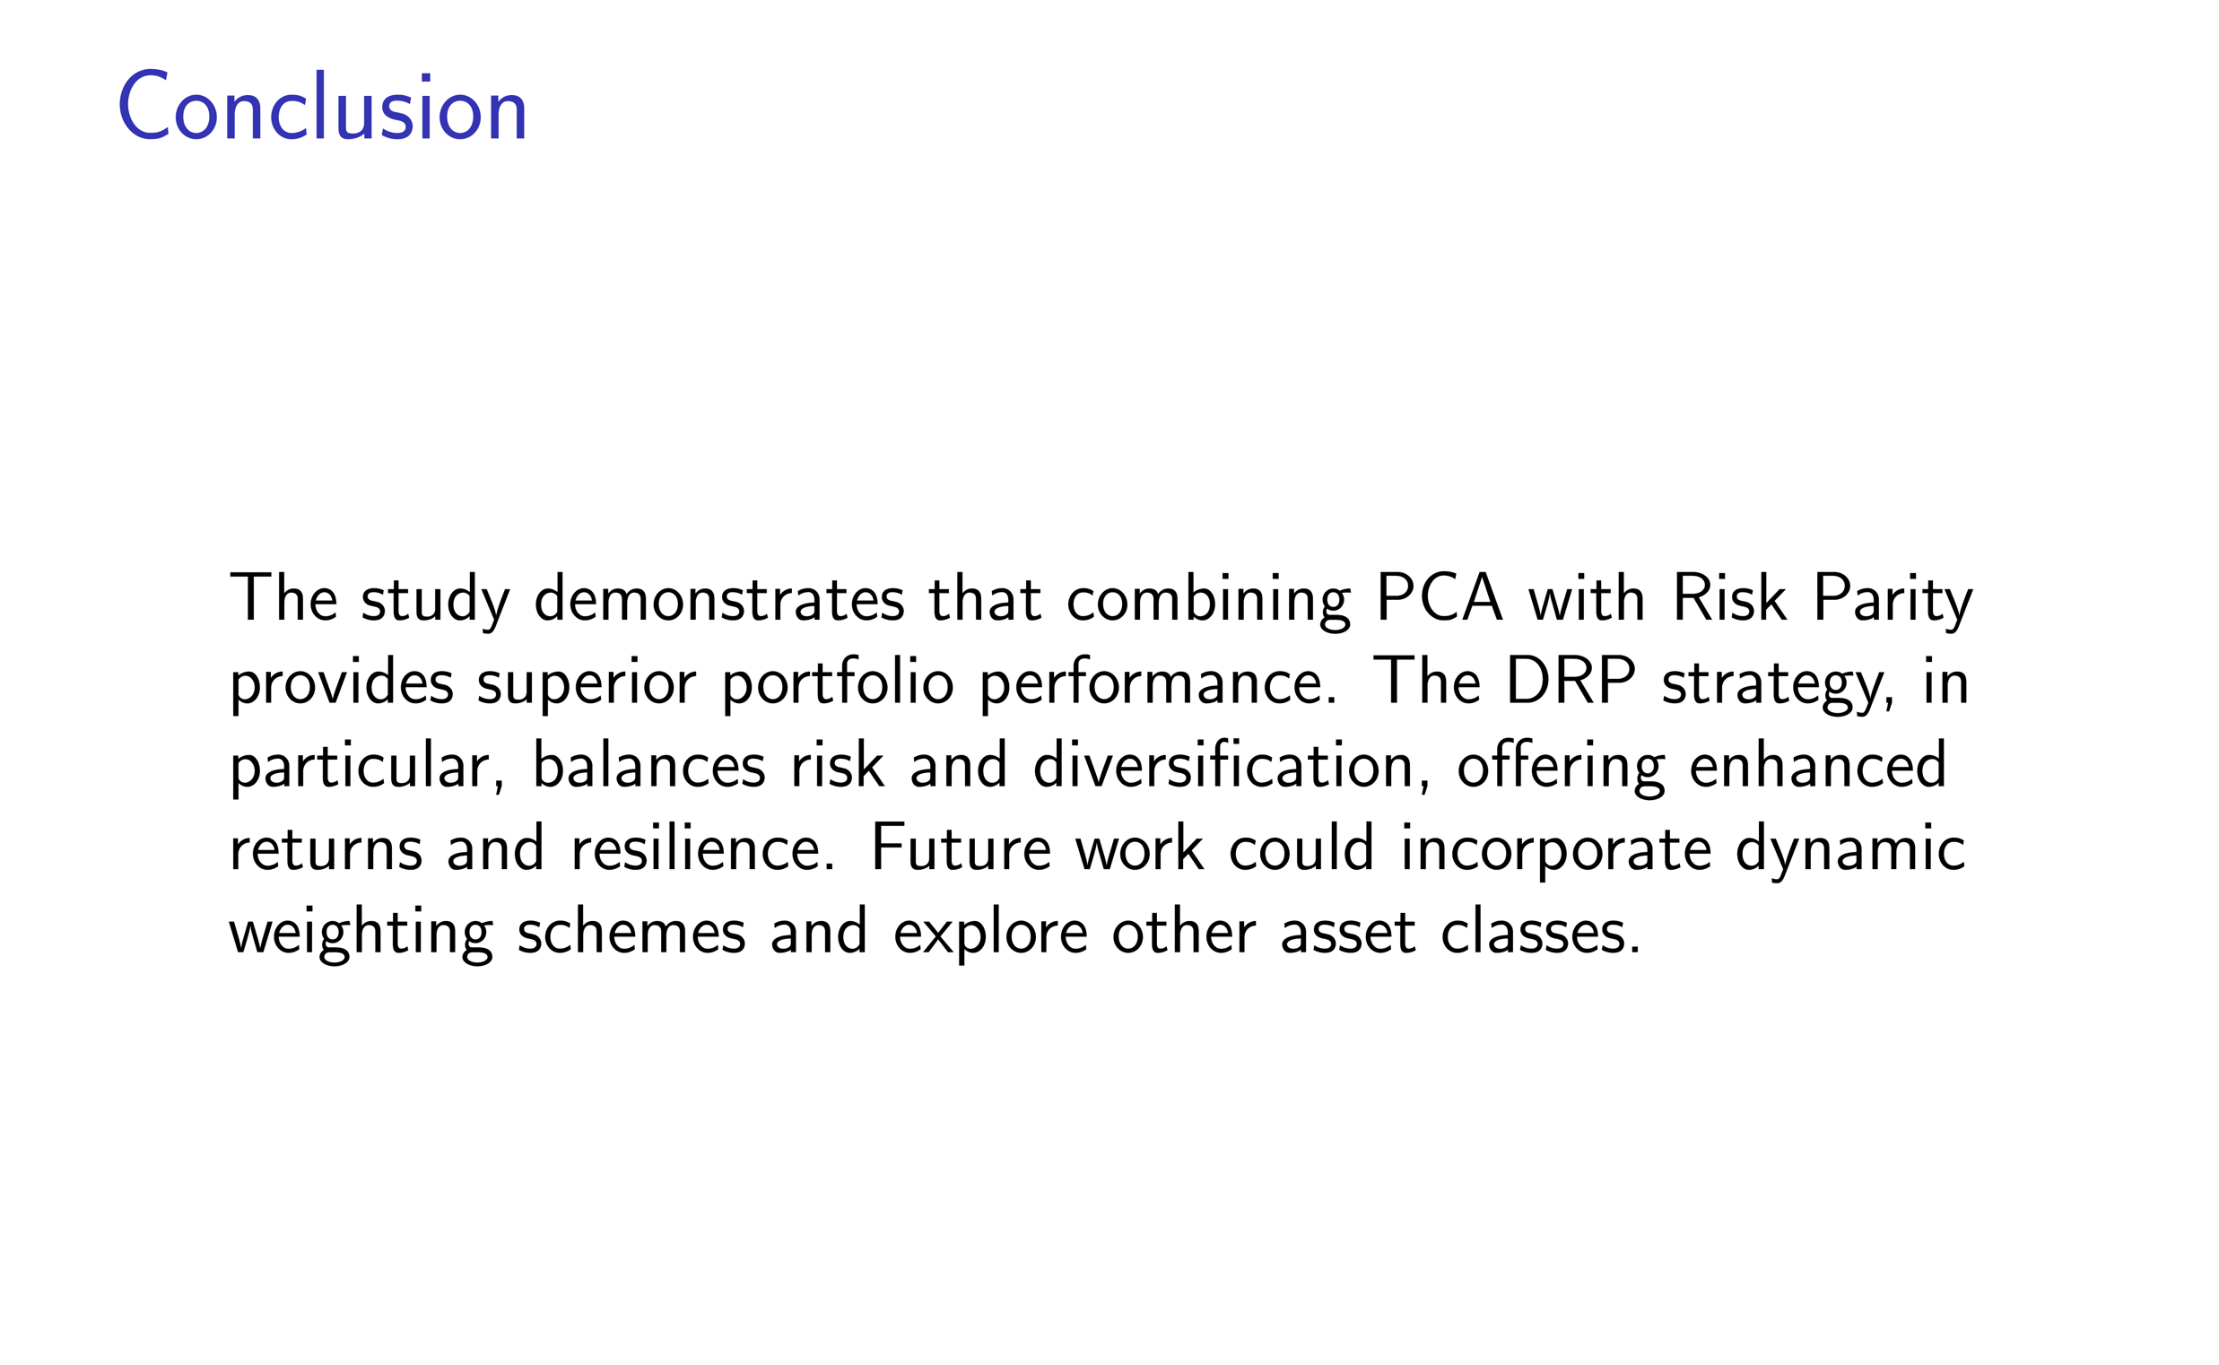

Slide 25
Q & A

Slide 26
